Slide 1

Stack Overflow Questions
Mahyar Sabouniaghdam

Slide 2


About me
MSc in Civil Engineering
Data Science Diploma
+6 Years Experience in Structural Design
Publication

Slide 3

Introduction
Problem Statement
Business Value
Every data scientist has a tab open to Stack Overflow
Questions can be closed:
Duplication
Off-topic or not related to programming
Lack of detail in the question
Not a real question

Slide 4


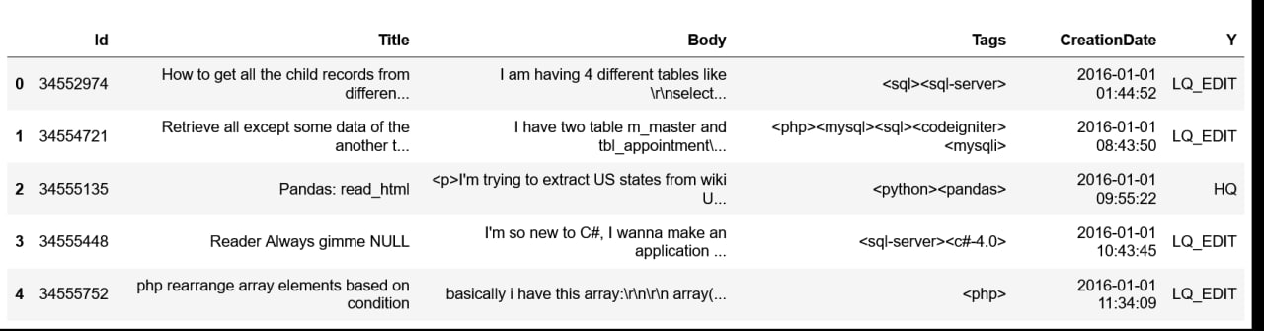
Data Description
Feature Engineering

Slide 5
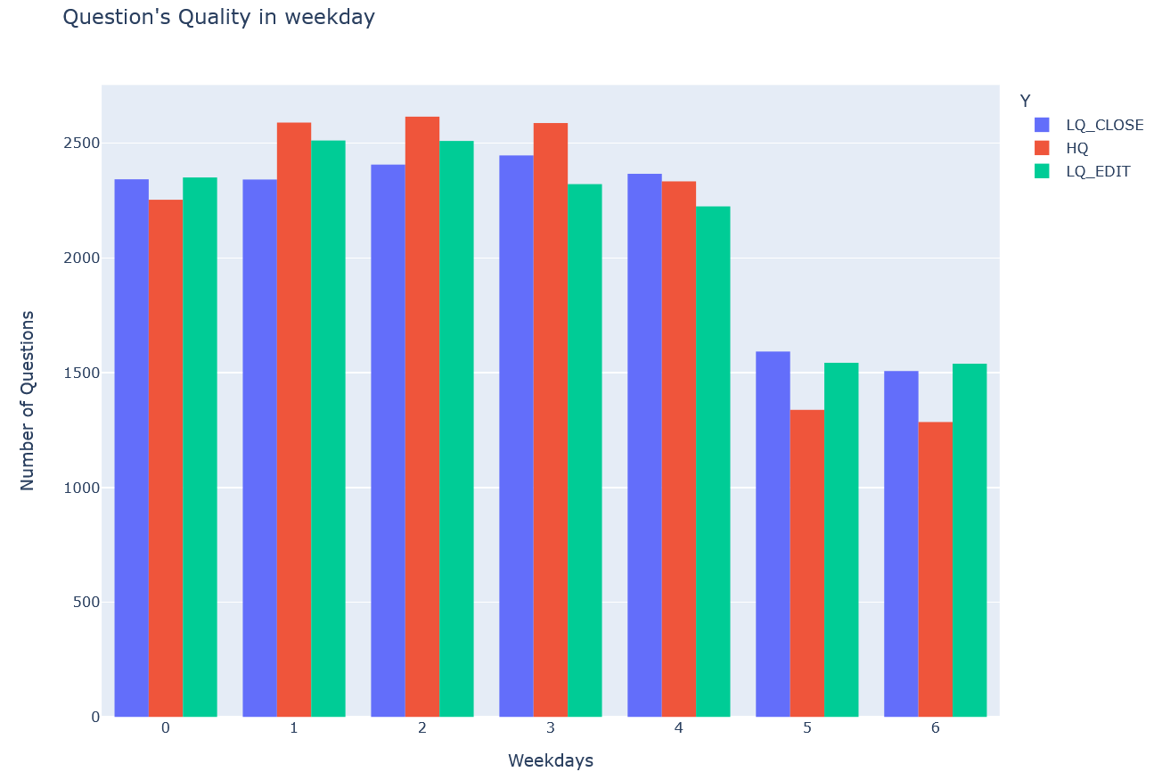
Weekday
Users created more questions at weekdays comparing to weekends.
At weekends, the portion of high-quality questions was the lowest.

Slide 6
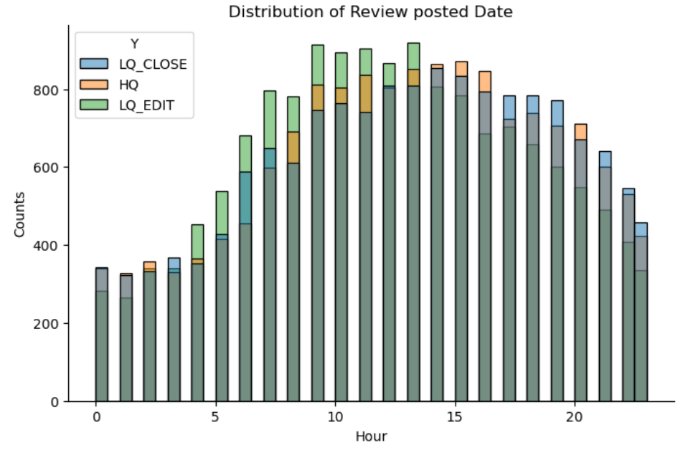
Hour
Most of the questions were created between 10am – 2pm.
Questions created at nights were more likely to be closed. (The blue colors on top)

Slide 7
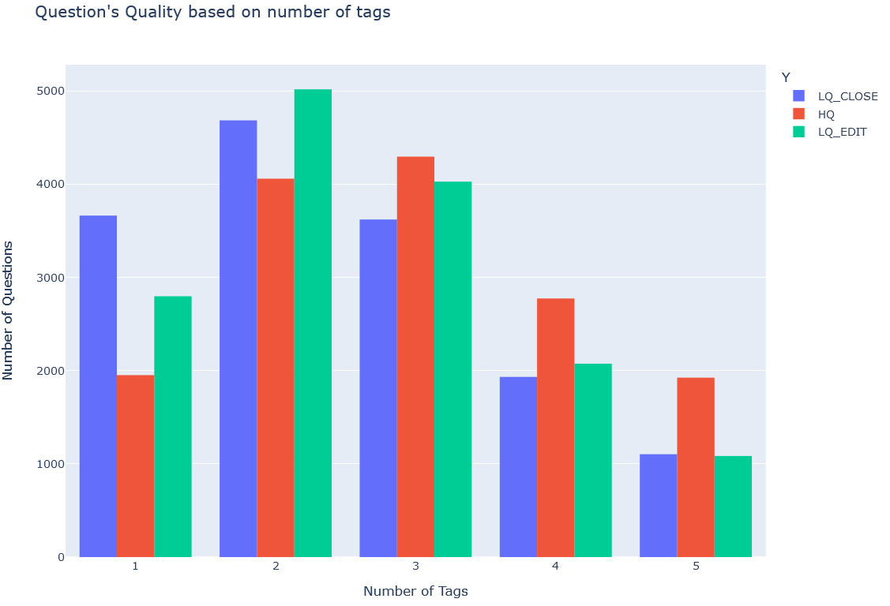
Number of Tags
Most questions had 2 tags.
The more number of tags we have, the greater chance to have a high-quality question.

Slide 8
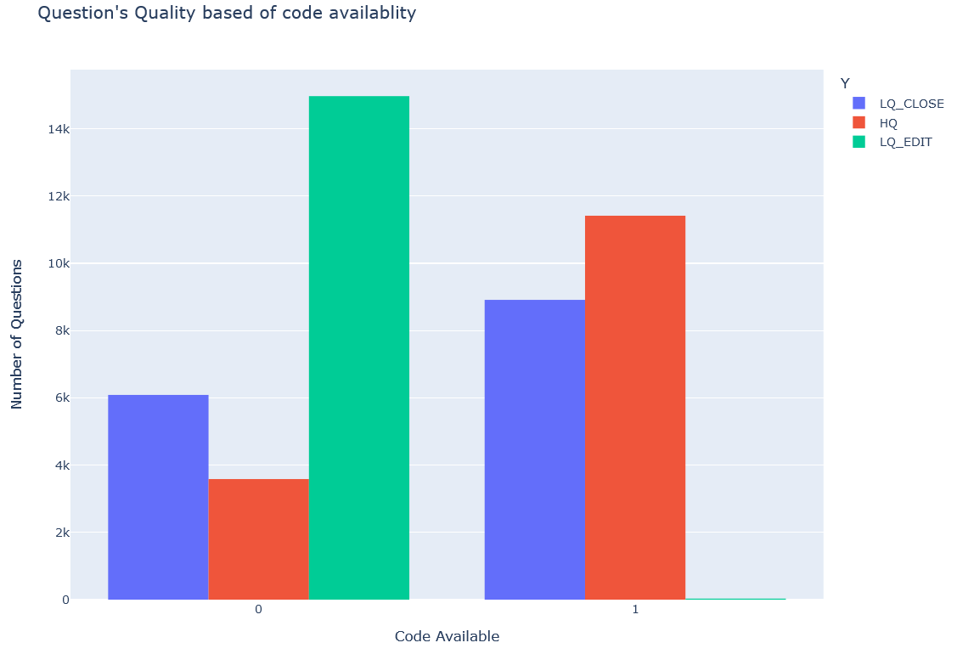
Code Availability
More than half of our questions did not have any codes.
When we have code in our question, the chance of having a High-Quality question is the highest.
Code Availability is a decisive factor.

Slide 9
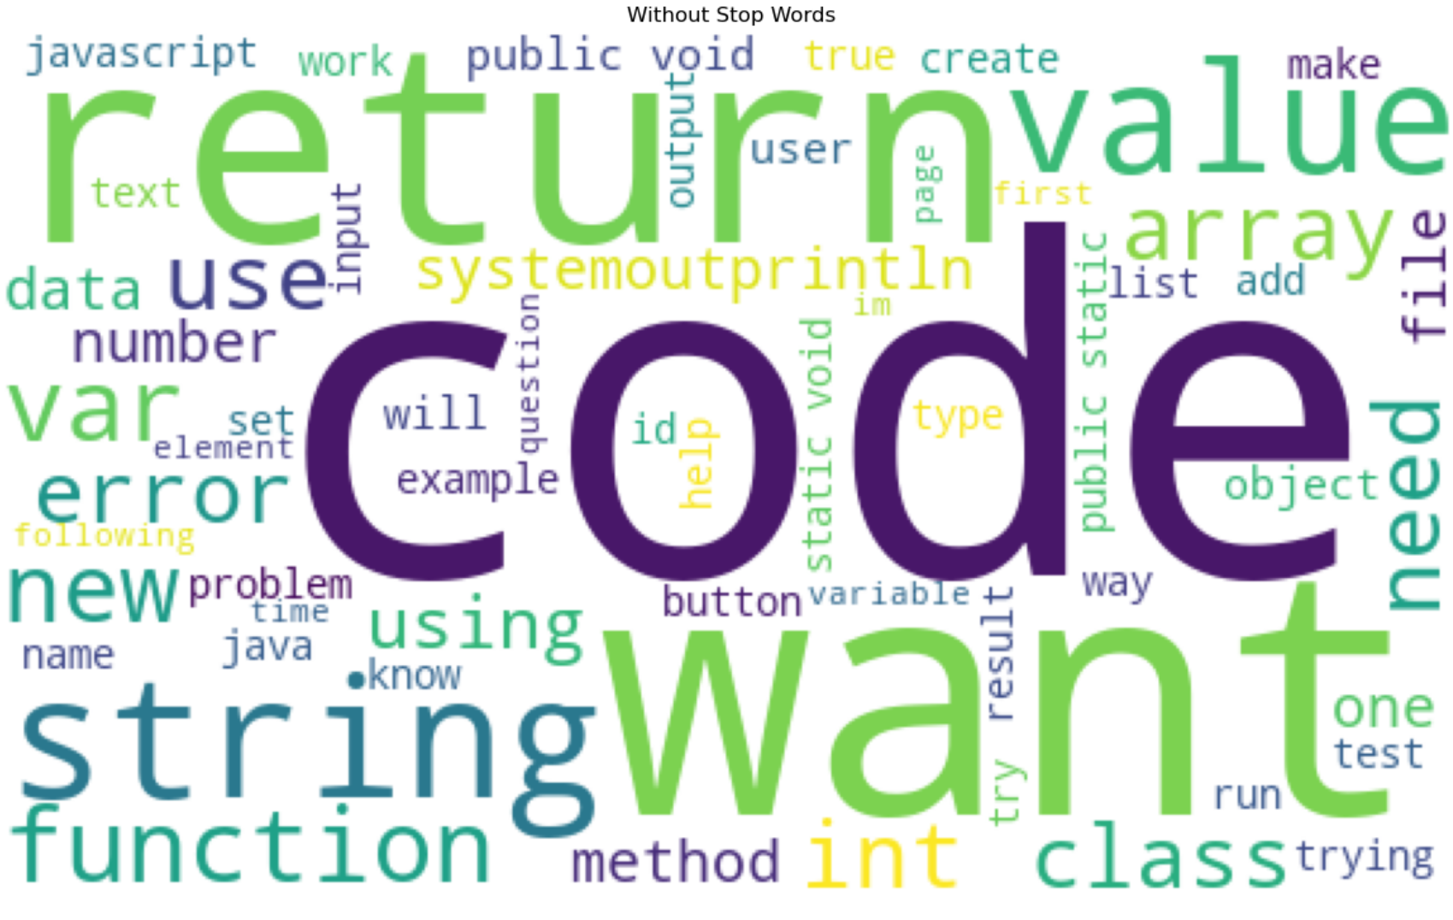
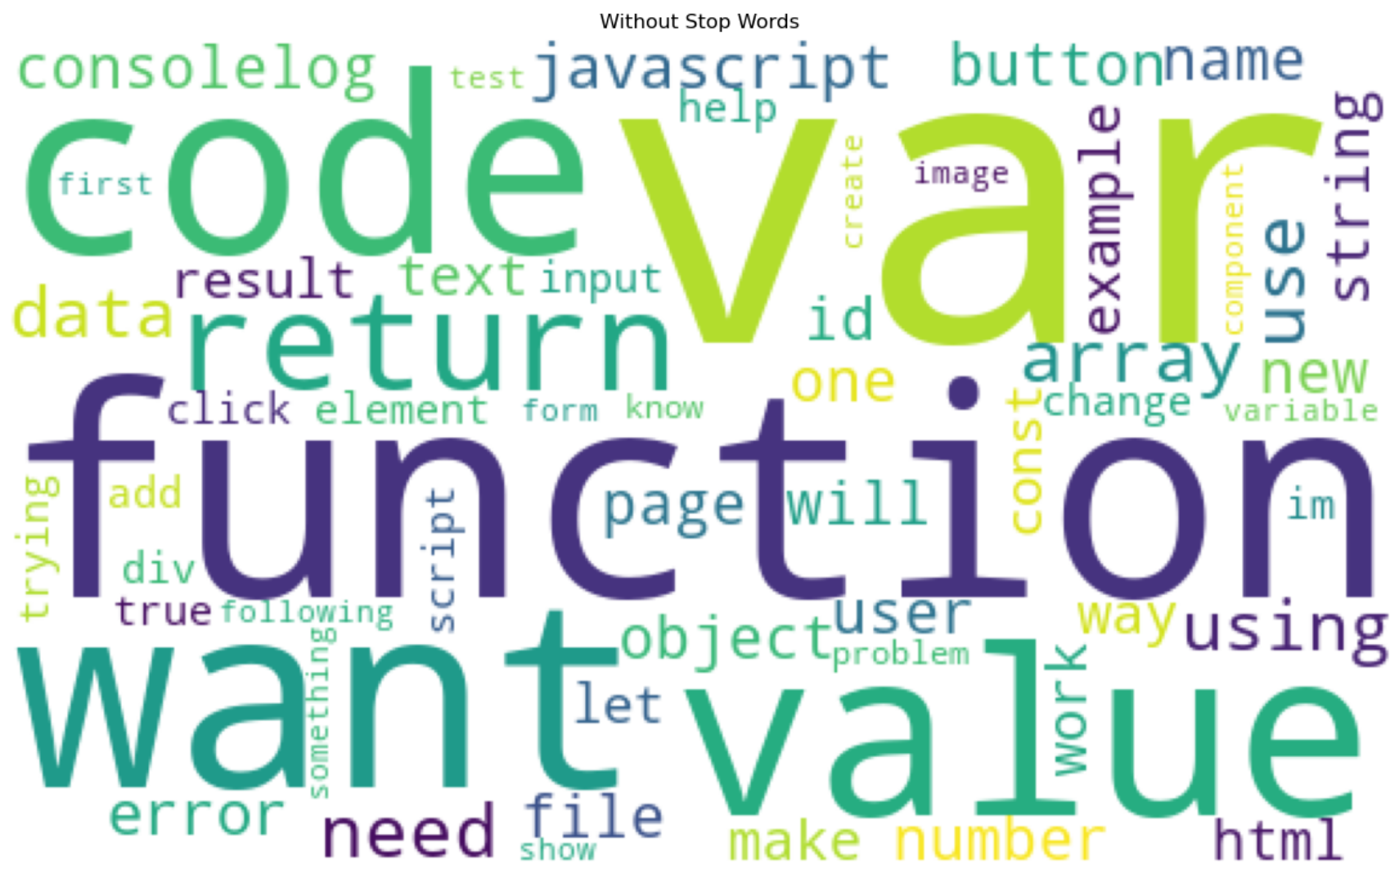
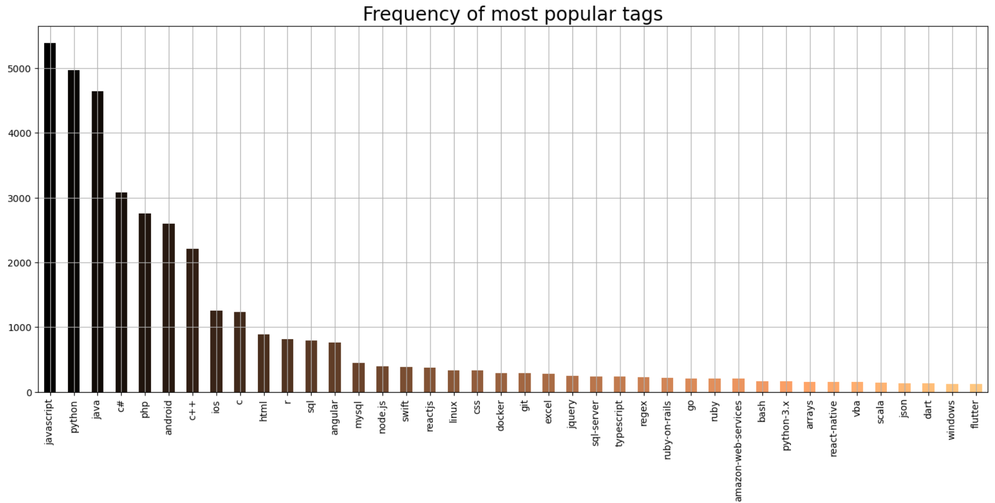
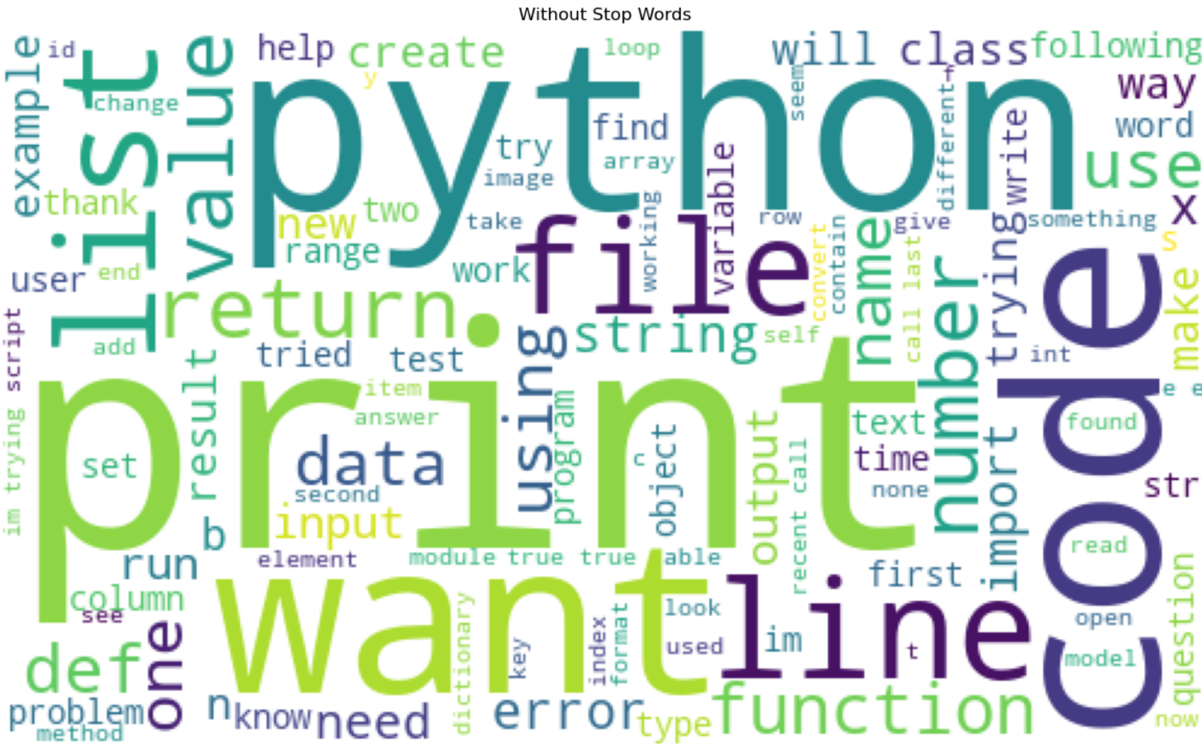
Popular Tags
JavaScript
Java
Python

Slide 10
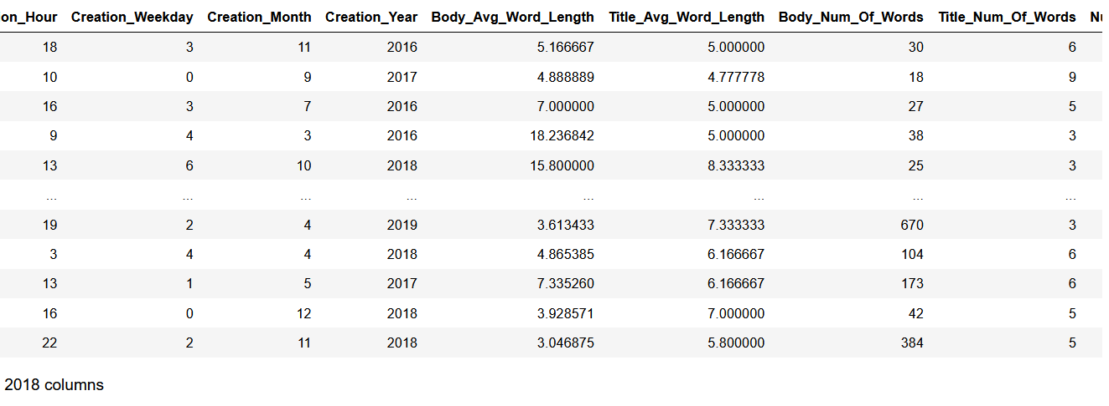
Final Dataset
TF – IDF Vectorization
2018 Columns

Slide 11
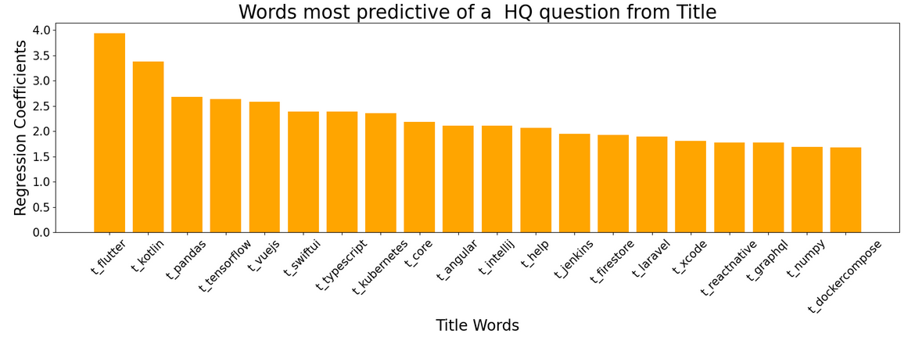
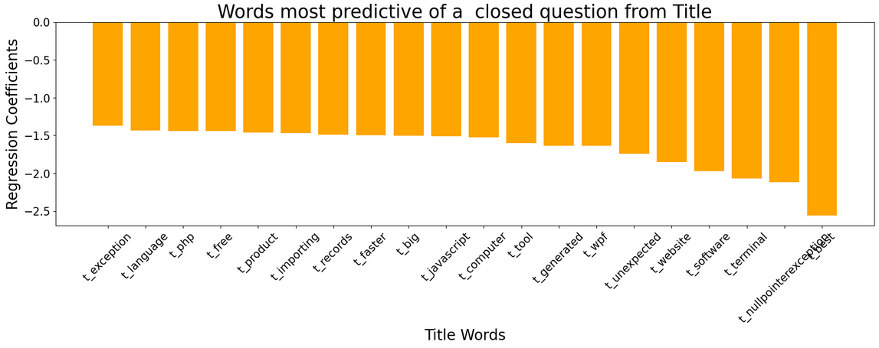
Title
Titles mostly 4-6 words.
Advanced, technical words predictive of HQ titles.
Top 20 closed Qs use general words; HQ Qs use advanced words.
Shorter, fewer words = higher chance of closed Qs.

Slide 12
Models
Models | Test Score | Train Score | Parameters
Logistic Regression | 75% | 77.31% | C_Value = 0.1
SVM | 75.25% | 83% | C_Value=0.01
Random Forrest | 73% | 84% | max_depth=21 n_est=13
XGBoost | 79% | 84.6% | max_depth=6 n_est=40
ANN | 70.5% | - | -
Multi Class NNs | 79% | - | More complex

Slide 13
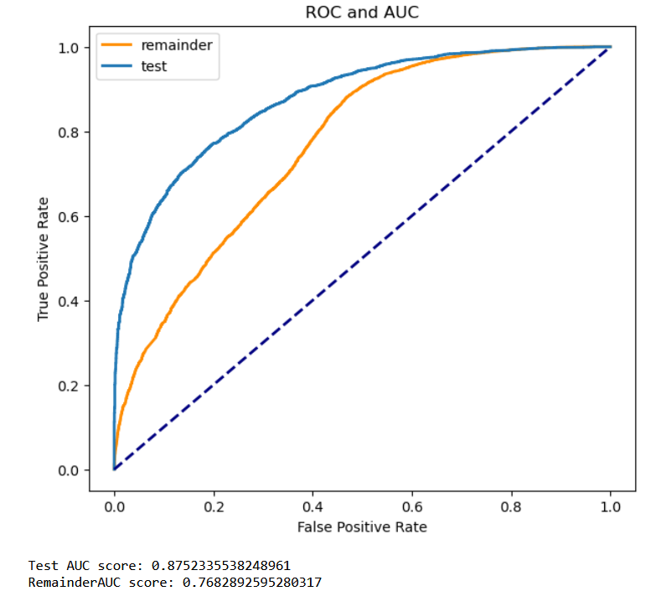
Closing Remarks
Out of 100 questions, 88 of them will be predicted correctly as a HQ question.
Test AUC Score: 0.88
Remainder AUC Score: 0.78

Slide 14
Next Steps
Search for less biased data.
Conduct a Word Embedding analysis.
Explore more advanced NLP Models.
Run an extensive ML Pipeline with GridSearch via AWS.
Develop an API to predict the quality rating of the questions.

Slide 15

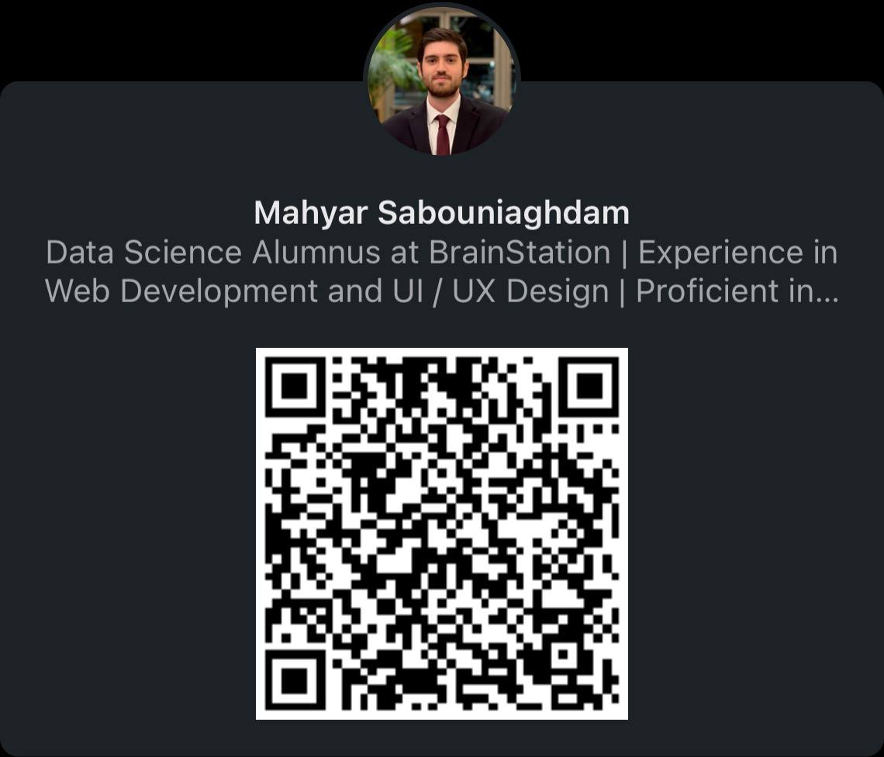



Connect with Me
github.com/mahyarsab
linkedin.com/in/mahyar-sabouniaghdam
saboonimahyar@gmail.com

